Slide 1




Reconstructing quantum states from
single-party information
Christian Schilling
University of Oxford
Zurich, 13 June 2018
in collaboration with
C.L.Benavides-Riveros (Halle) & P.Vrana (Budapest)
R.Schilling (Mainz)
Notes:
1

Slide 2



Slide 3
Outline
(I) Quantum marginal problem
(II) Extremal local information
(III) Quasiextremal local information
(IV) Applications

Slide 4
(I) Quantum marginal problem (QMP)
A
C
E
D
B
given states for these subsystems
Q: Are they compatible, i.e. can they arise from
the same total state ?

Slide 5





pure univariate QMP :
non-overlapping (univariate)
marginals
A
C
D
B
+
total state is pure
unitary equivalence:
only spectra are relevant for compatibility !

Slide 6





Solution
collect all spectra of interest:
with
Q: Area of compatible spectra (marginals)?
compatible
spectra
form a high-dimensional polytope P
A:
its facets/form depend on concrete version of the QMP
[A.Klyachko, J. Phys. Conf. Ser. 36, 72, 2006]
[M.Altunbulak, A.Klyachko, CMP 282, 287, 2008]
[M.Altunbulak, PhD thesis, Bilkent University, 2008]

Slide 7



Example 1: N qubits
smaller eigenvalue of state
polytope:
[Higuchi et al., Phys. Rev. Lett. 90, 107902, 2002]

Slide 8




Example 2: 3 fermions & 6 orbitals
[Borland & Dennis, J.Phys. B 5, 1, 1972]
[Ruskai, Phys. Rev. A 40, 45, 2007]
Review on the QMP and its physical relevance:
[CS, Proceedings QMath12, World Scientific, Singapore, 2015, arXiv:1404.1085]

Slide 9




(II) Extremal local information
1
0
1
[CS, Phys. Rev. B 92, 155149 (2015)]

Slide 10




Slide 11



Example 1: N qubits

Slide 12
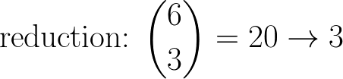
Example 2: 3 fermions & 6 orbitals

Slide 13





[F.Tennie, D.Ebler, V.Vedral, CS, Phys. Rev. A 93, 042126 (2016)]
[F.Tennie, V.Vedral, CS, Phys. Rev. A 94, 012120 (2016)]
and many further papers

Slide 14

International workshop on this new research field
See website
www.physics.ox.ac.uk/confs/pauli2016
for recorded talks, slides, posters,...

Slide 15

(III) Quasiextremal local information
[CS, C.Benavides-Riveros, P.Vrana, Phys. Rev. A 96, 052312, 2017]

Slide 16









Proof

Slide 17




Slide 18


Slide 19

(IVa) Extension of Hartree-Fock ansatz

Slide 20



Slide 21
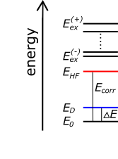

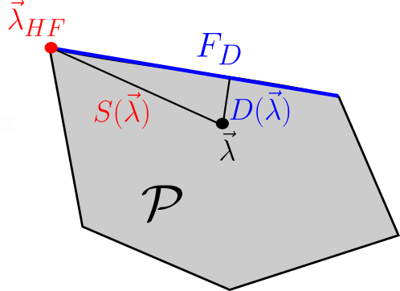
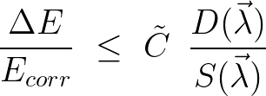


Slide 22




Hierarchy of MCSCF ansatzes

Slide 23







(IVb) 1RDM-Functional Theory

Slide 24
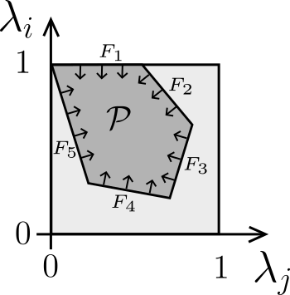
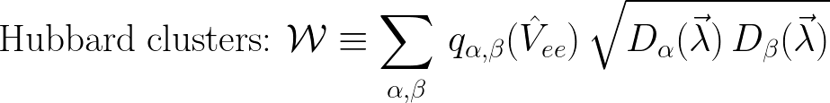

Slide 25





Conclusion

Slide 26
Thank you!

Slide 27
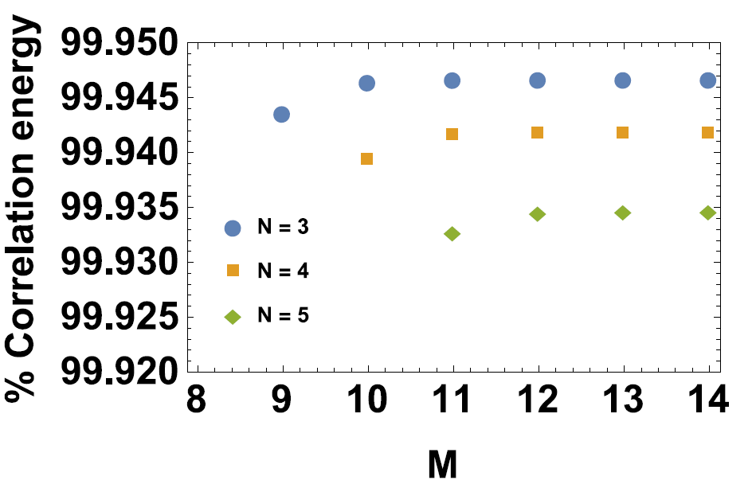
Numerical test
[C.Benavides-Riveros, CS, Z. Phys. Chem. 230, 5-7 (2016)]

