Slide 1




Introduction to generalized Pauli constraints
and their applications
Christian Schilling
University of Oxford
Torun, 21st June 2018
in collaboration with:
F.Tennie (Oxford), D.Ebler (Hong Kong), V.Vedral (Oxford);
A.Lopes (Freiburg), P.Vrana (Budapest); C.L. Benavides-Riveros (Halle);
M.Altunbulak (Izmir), S.Knecht (ETH Zurich), M.Reiher (ETH Zurich),...;
O.Legeza (Budapest);
R.Schilling (Mainz)
Notes:
1

Slide 2




Slide 3









1
0
1

Slide 4




example: N = 3 & d= 6
[R.E.Borland, K.Dennis, J. Phys. B, 5, 1, 1972]
[M.B.Ruskai, Phys. Rev. A, 40, 45, 2007]
in general: finite family of generalized Pauli constraints
[A.Klyachko, J. Phys 36, 72-86, 2006]
[M.Altunbulak, A.Klyachko, CMP 282, 287-322, 2008]
[M.Altunbulak, PhD thesis, Bilkent University, 2008]

Slide 5
Outline
Study of concrete systems
Relevance of (quasi)pinning
Applications

Slide 6

1) Study of concrete systems
Position of relevant states
(e.g. ground state) ?
or here ? (pinning)
1
here ?
0
1

Slide 7
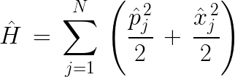

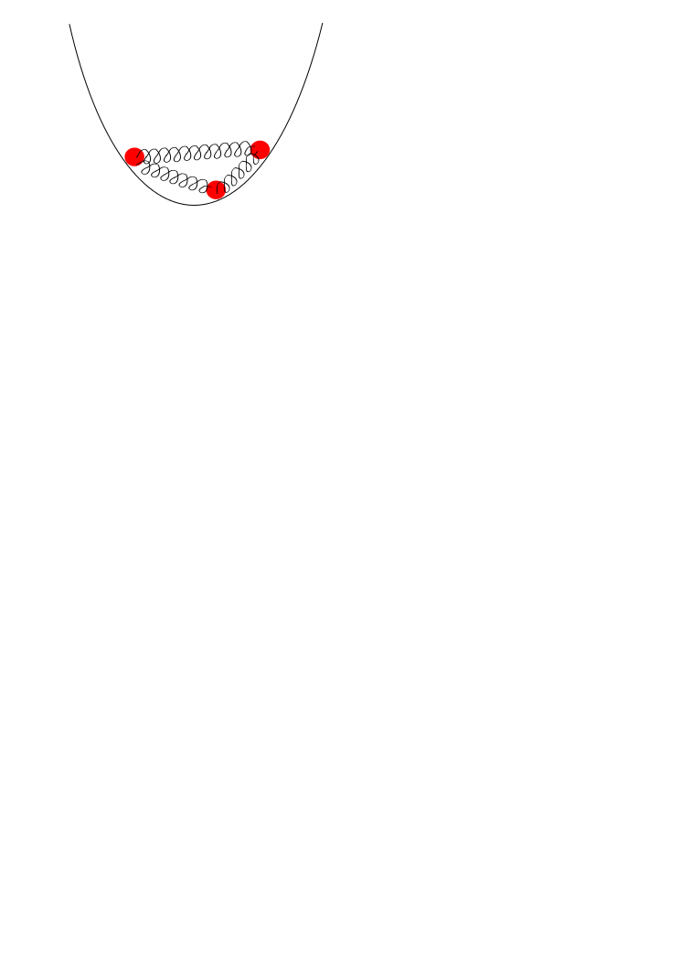




Harmonic model system

Slide 8
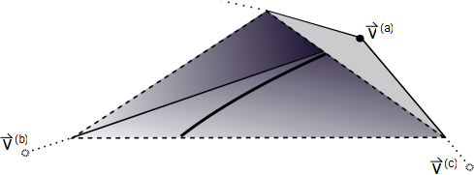



[CS, PhD thesis, ETH Zurich (2014)]
[ Phys. Rev. Lett. 110, 040404 (2013)]

Slide 9




1
0
1

Slide 10




[F.Tennie, D.Ebler, V.Vedral, CS, Phys. Rev. A 93, 042126 (2016)]
[F.Tennie, V.Vedral, CS, Phys. Rev. A 94, 012120 (2016)]
[F.Tennie, V.Vedral, CS, Phys. Rev. A 95, 022336 (2017)]
[O.Legeza, CS, Phys. Rev. A 97, 052105 (2018)]
and many further papers in quantum chemistry

Slide 11
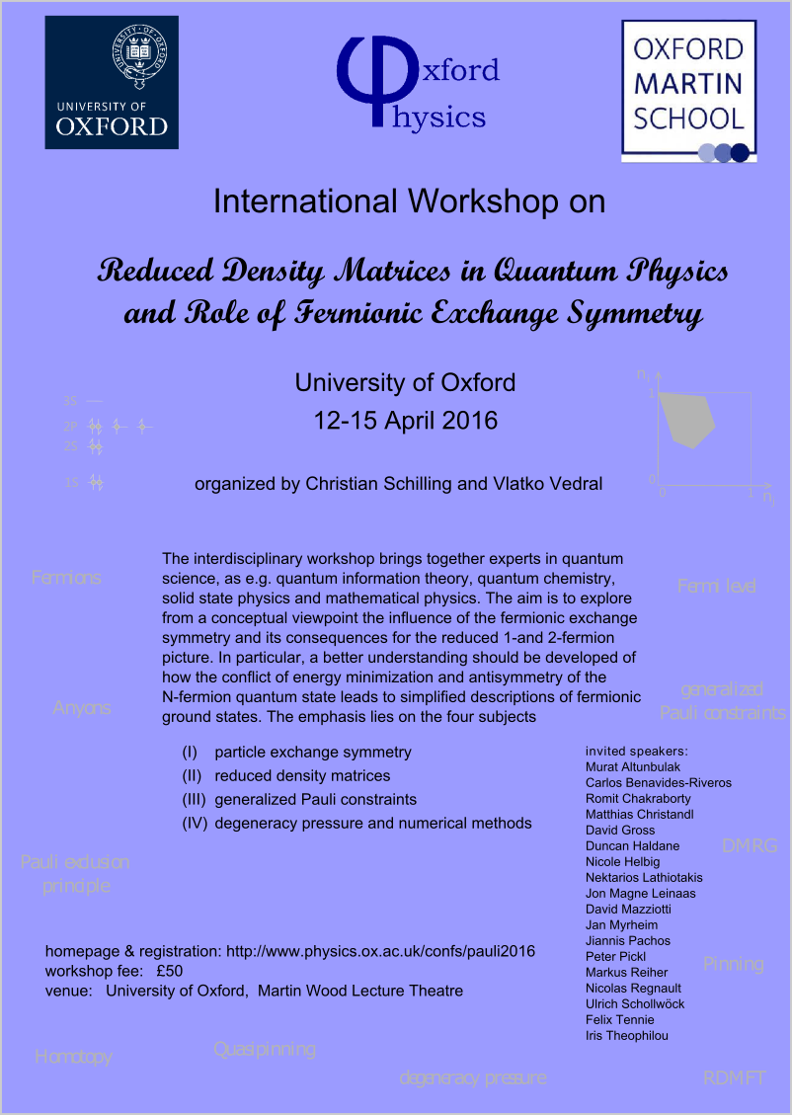
International workshop on this new research field
See website
www.physics.ox.ac.uk/confs/pauli2016
for recorded talks, slides, posters,...

Slide 12
2) Relevance of (quasi)pinning
pinning
point on boundary :
restricted dynamics
0
1
decay
impossible
generalization of:

Slide 13




Slide 14

3a) Ground state problem

Slide 15

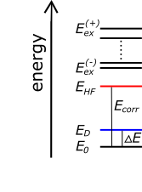
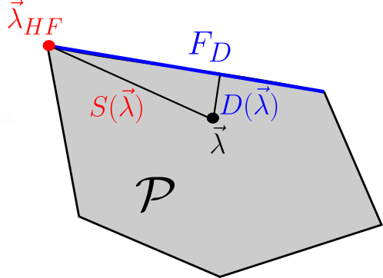
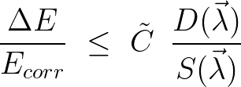

Slide 16




Hierarchy of MCSCF ansatzes

Slide 17







(IVb) 1RDM-Functional Theory

Slide 18
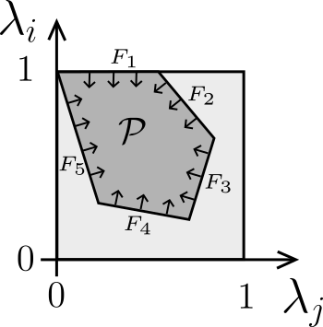
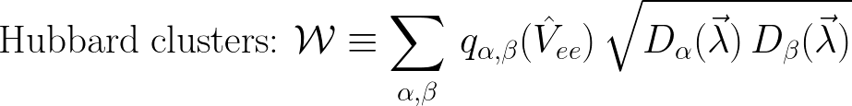

Slide 19

Conclusion

Slide 20
Thank you!

Slide 21

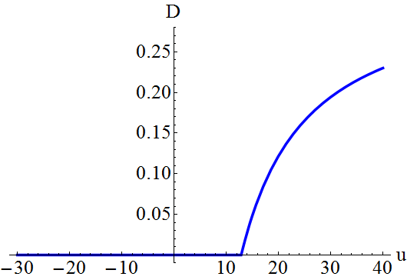
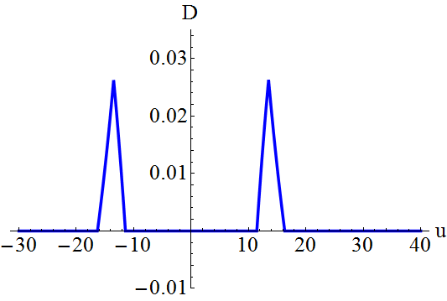
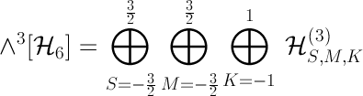
Hubbard model
e.g. 3 electrons on 3 sites:
ground state
excited state
pinning requires symmetries:
[CS, Phys. Rev. B 92, 155149 (2015)]

Slide 22





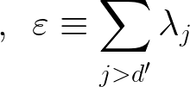
1
0
1
???

Slide 23
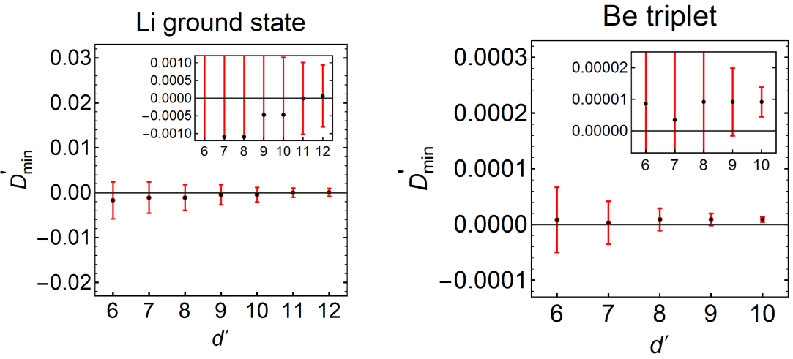
[CS, M.Altunbulak, S.Knecht, A.A.Lopes, J.D.Whitfield, M.Christandl, D.Gross, M.Reiher: Phys. Rev. A 97, 052503 (2018)]

Slide 24
Quantum Chemistry:
(quasi)pinning
[C.L.Benavides-Riveros, J.M.Gracia-Bondia, M.Springborg:
Phys. Rev. A 88, 022508 (2014); arXiv:1409.6435; Phys. Rev. A 92, 012512 (2015);
Chem. Mod. 14, 71 (2018)]
[R.Chakraborty, D.A.Mazziotti:
Phys. Rev. A 89, 042505 (2014); Phys. Rev. A 91, 010101 (2015);
Int. J. Quant. Chem. 115, 1305 (2015); Int. J. Quant. Chem. 116, 784 (2016);
J. Chem. Phys. 148, 054106 (2018)]
[I.Theophilou, N.N.Lathiotakis, M.A.L.Marques, N.Helbig:
J. Chem. Phys. 142, 154108 (2015); J. Chem. Theory Comput. 12, 2668 (2016);
J. Chem. Phys. 148, 114108 (2018)]
[CS, M.Altunbulak, S.Knecht, A.A.Lopes, J.D.Whitfield, M.Christandl,
D.Gross, M.Reiher:
Phys. Rev. A 97, 052503 (2018)]

Slide 25


detector
physical
system
1
[CS, Phys. Rev. B 92, 155149 (2015)]
0
1

Slide 26


structual simplifications for N-fermion state
1
0
1
stable:

