Slide 1
Quantum Marginal Problem and its Physical Relevance
Christian Schilling
ETH Zurich
Credits: M.Christandl & D.Gross
A.Klyachko
QMath12, 10.September 2013
Notes:
1

Slide 2
Outline
Quantum Marginal Problem
Solution and Proof (A.Klyachko)
Generalized Pauli Constraints
Physical Relevance

Slide 3





1) Quantum Marginal Problem
A
C
multipartite
quantum system
D
B
E
Hilbert space
states
e.g.
marginal

Slide 4
example:
system + reservoir
some subsystems of
interest, e.g. AB, AC, E :
A
C
E
D
B
given states for these subsystems
Q: Are they compatible, i.e. are they belonging to
the same total state ?

Slide 5
determine all compatible tuples
Quantum Marginal Problem
additional assumptions:
total state is pure
if subsystems identical: (skew-)symmetric states
…
in general: impossible to solve QMP !
simplification:

Slide 6




pure univariant QMP :
A
C
non-overlapping (univariant)
marginals
D
B
+
total state is pure
unitary equivalence:
only spectra are relevant for compatibility !

Slide 7




2A) Solution
[A.Klyachko., CMP 282, p287-322, 2008]
[A.Klyachko, J.Phys 36, p72-86, 2006]
collect all spectra of interest:
with
Q: Area of compatible spectra (marginals)?
compatible
spectra
form a high-dimensional polytope
A:
its facets/form depend on concrete version of the QMP

Slide 8



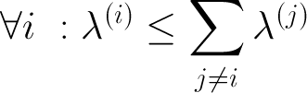
example: N qubits
smaller eigenvalue of state
polytope:
Higuchi et al., Phys. Rev. Lett. 90, 107902 (2002)

Slide 9

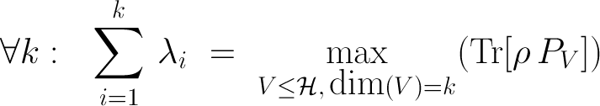
2B) Sketch of Proof
depends on version
A
B
strategy for
Ky Fan:

Slide 10
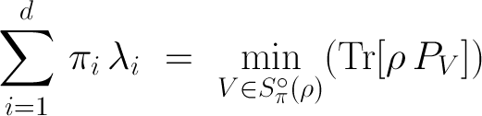



generalization:
Hersch-Zwahlen:
Schubert variety of the Grassmannian; beautiful object !
A
B

Slide 11
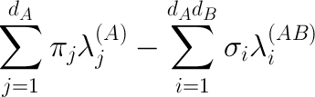
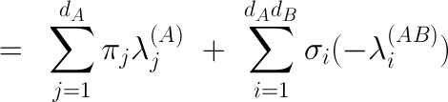


( )

Slide 12




Goal:
analysis of intersection property
( )
several inequalities
increases rapidly when dimensions increase
checking for one impossible
( )
and how?
with Schubert Calculus (algabraic topology)

Slide 13





3) Generalized Pauli Constraints
1
natural occupation numbers
0
1

Slide 14







Example: N = 3 & d= 6
[Borland&Dennis, J.Phys. B, 5,1, 1972]
[Ruskai, Phys. Rev. A, 40,45, 2007]

Slide 15


4) Physical Relevance
or here ? (pinning)
position of relevant states ?
1
Slater determinants
here ?
point on boundary :
0
1
equality
decay
impossible
kinematical constraints
generalization of:

Slide 16
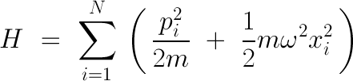
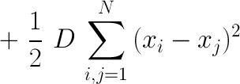



physical model
fermionic ground state:
[Z.Wang et al., arXiv 1108.1607, 2011]
if non-interacting

Slide 17










hierarchy:

Slide 18







pinning analysis
too difficult/
not known yet
instead: check w.r.t

Slide 19


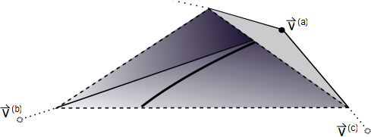



relevant as long
as
lower bound on
pinning order

Slide 20







relevant as long
as
quasi-pinning
C.Schilling et al.
Phys. Rev. Lett. 110, 040404 (2013)

Slide 21


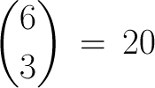
what is pinning good for?
(quasi) pinning
very specific structure
of
Example:
dimension
Pinning of

Slide 22


Application: Improvement of Hartree-Fock
approximate unknown ground state
Hartree-Fock
much better:

Slide 23

Conclusions
solution of pure, univariant QMP (Klyachko)
antisymmetry of
translated to 1-particle picture
generalized
Pauli constraints
study of fermion – model with coupling
generalized Pauli constraints pinned up to corrections
pinning is physically relevant
e.g.
improve Hartree-Fock
fermionic ground states simpler than appreciated (?)

Slide 24
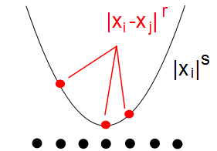
Outlook
generic for:
Hubbard model
quantum chemistry: atoms
physical & mathematical intuition
for pinning
strongly correlated fermions?
antisymmetry energy minimization

Slide 25
Thank you!

Slide 26




Schubert cells
and eigenspace corresponding to
Now:
Then, whenever
( )
we get a spectral inequality:

