Slide 1


Fermionic Exchange Symmetry:
Quantifying its Influence beyond Pauli's Exclusion Principle
Christian Schilling
University of Oxford
Leeds, 10 February 2016
in collaboration with:
F.Tennie, D.Ebler, V.Vedral
C.Benavides-Riveros
M.Christandl, D.Gross, A.Lopes
Notes:
1

Slide 2


Pauli’s exclusion principle (1925):
`no two identical fermions in
the same quantum state’
modern version:
(quasi-) pinned by
(quasi-) pinned by
relevant when
Aufbau principle for atoms

Slide 3
strengthened by Dirac & Heisenberg in (1926):
`quantum states of identical
fermions are antisymmetric’
implications for occupation numbers ?
further constraints beyond

Slide 4
Outline
Generalized Pauli constraints
Study of concrete systems
Relevance of (quasi)pinning
Projects

Slide 5






1) Generalized Pauli constraints
N-fermion states
partial trace
1-particle reduced density operator
natural occupation
numbers

Slide 6





polytope
1
0
1
[A.Klyachko, J.Phys 36, p72-86, 2006]
[M.Altunbulak,A.Klyachko, CMP 282, 2008]
Pauli exclusion principle

Slide 7
polytope
=
intersection of
finitely many half spaces
facet:
half space:

Slide 8







example: N = 3 & d= 6
[Borland&Dennis, J.Phys. B, 5,1, 1972]
[Ruskai, Phys. Rev. A, 40,45, 2007]

Slide 9

2) Study of concrete systems
Position of relevant states
(e.g. ground state) ?
or here ? (pinning)
1
here ?
0
1

Slide 10
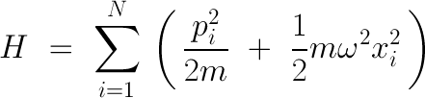
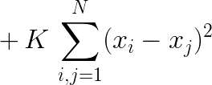





Harmonium
restrict to
trick for weak couplings:
duality [CS, R.Schilling, J. Phys. A, 47, 415305 (2014)]

Slide 11







tremendous effort
N = 3

Slide 12







pinning analysis
too difficult/
not known yet
instead: check w.r.t
`concept of truncation’ [CS, PhD thesis, ETH Zurich, 2014]

Slide 13


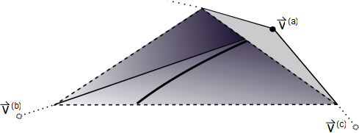



relevant as long
as
lower bound on
pinning order

Slide 14







relevant as long
as
quasipinning
Phys. Rev. Lett. 110, 040404 (2013)

Slide 15


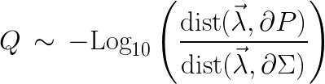

How about
intermediate couplings?
more particles?
higher spatial dimensions?
After all, how nontrivial are these findings?:
???
1
[F.Tennie, V.Vedral, CS, arXiv:1509.00358]
0
1

Slide 16
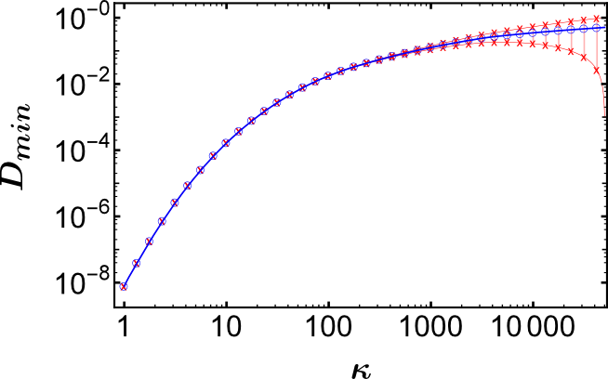

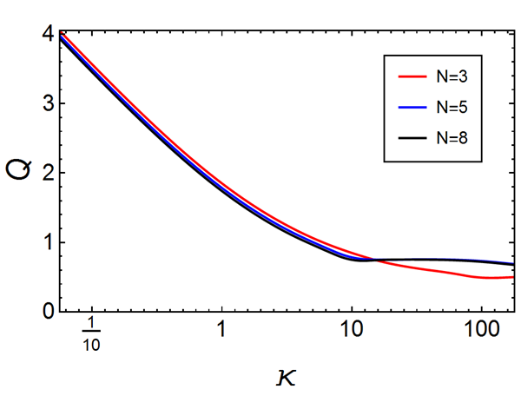

intermediate
couplings:
more particles:
nontriviality:

Slide 17
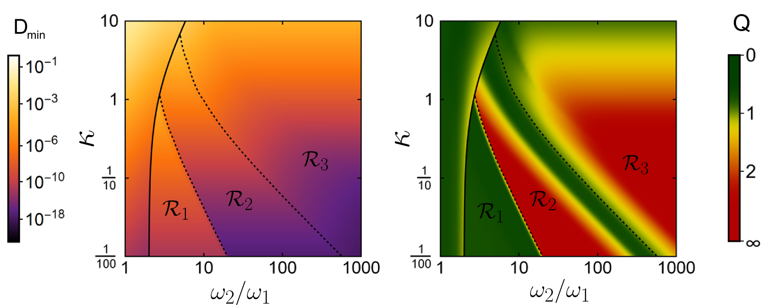
higher spatial dimensions & crossovers:
… many further plots …
[F.Tennie, D.Ebler, V.Vedral, CS, soon on the arXiv]

Slide 18

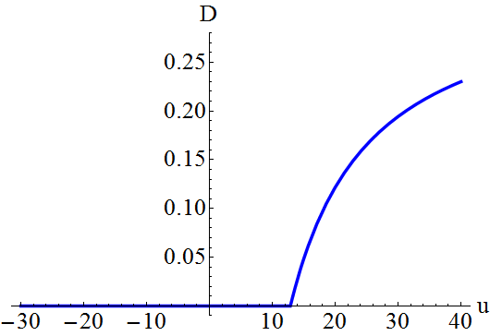
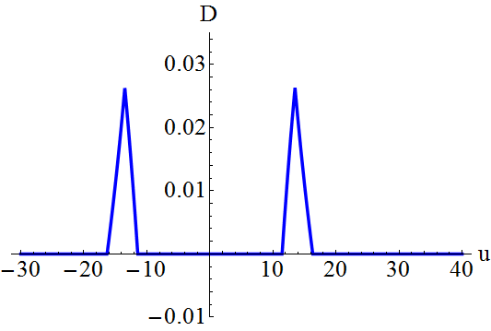
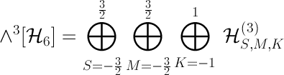
Hubbard model
e.g. 3 electrons on 3 sites:
ground state
excited state
pinning requires symmetries:
[CS, Phys. Rev. B 92, 155149 (2015)]

Slide 19
3) Relevance of (quasi)pinning
pinning
point on boundary :
restricted dynamics
0
1
decay
impossible
generalization of:

Slide 20


structual simplifications for N-fermion state
1
0
1
stable:

Slide 21
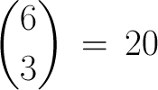


example:
dimension
pinning by
pinning of
structure of
with A.Lopes & D.Gross
stable! [CS, Phys. Rev. A 91, 022105 (2015)]

Slide 22


4)Projects
Generalized Hartree-Fock method
approximate unknown ground state
Hartree-Fock
much better:

Slide 23
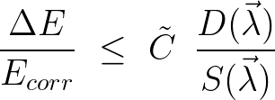

Numerical quality?
[CS, C.Benavides-Riveros (2016)]

Slide 24
Quantum Chemistry: atoms
numerical tools: configuration interaction
physical & mathematical
intuition for quasipinning
mechanism behind it
HOMO-
LUMO-
gap
strongly correlated fermions
fractional quantum Hall states

Slide 25


Experiments
measure (quasi)pinning
a) measure occupation numbers
b) no-go effects/transparency
1
0
1
detector
physical
system
[CS, Phys. Rev. B 92, 155149 (2015)]

Slide 26

Conclusions
antisymmetry of
translated to 1-particle picture
generalized
Pauli constraints
study of N-fermion-model with coupling
generalized Pauli constraints nontrivially saturated by quasipinning
GPC relevant beyond PEP
quasipinning weaker in higher dimensions
(quasi)pinning is physically relevant
e.g.
improve Hartree-Fock
fermionic ground states simpler than expected (?)

Slide 27
Thank you!

