Slide 1



Introduction into fermionic correlation and
applications in quantum chemistry
Christian Schilling
University of Oxford
Budapest, 28 September 2018
in collaboration with O.Legeza, S.Szalay and Z.Zimboras (Budapest)
Notes:
1

Slide 2

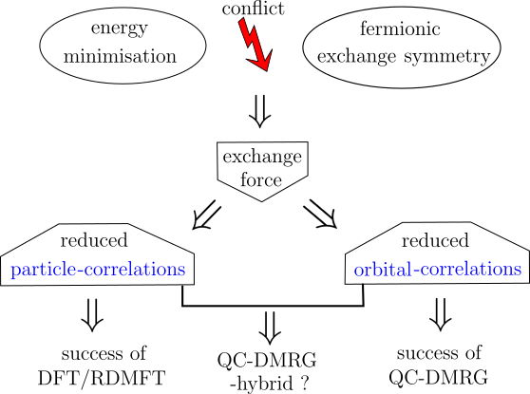

Slide 3
Outline
(I) Fermionic (quantum) correlation
(II) Application/Illustration in concrete systems

Slide 4



(I) Fermionic (quantum) correlation

Slide 5


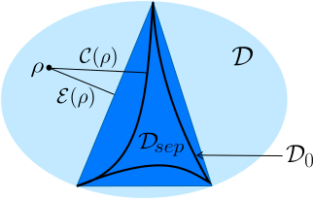
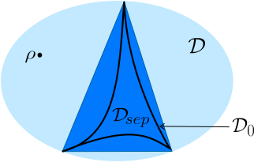
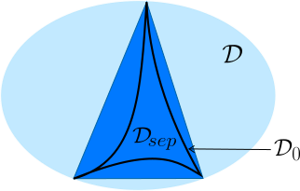

Slide 6


Slide 7





Slide 8




Slide 9




Slide 10





Slide 11





(II) Application/Illustration in concrete systems

Slide 12





Slide 13




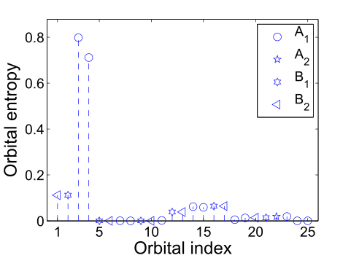
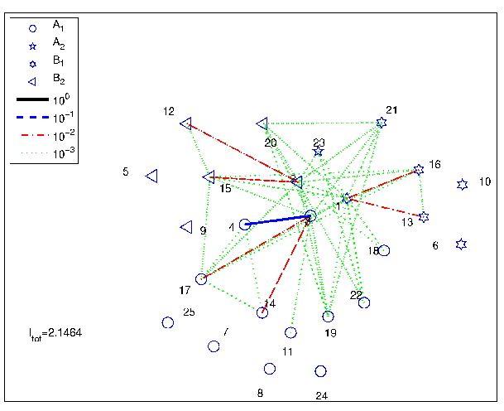

Slide 14




Slide 15





Slide 16
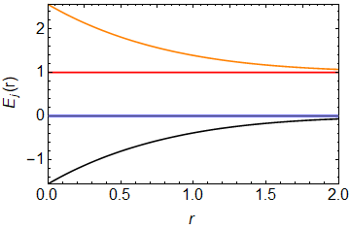

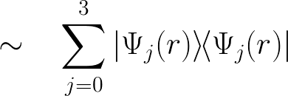


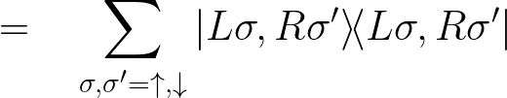

Slide 17
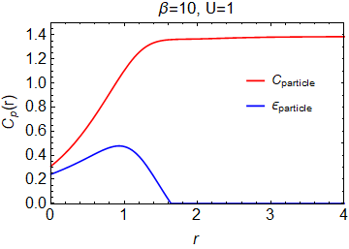




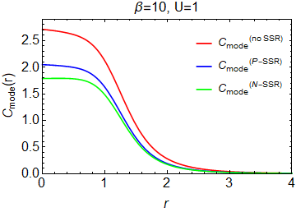
p
m

Slide 18
Thank you!

