Slide 1







Influence of the fermionic exchange symmetry
on the 1-particle picture
in collaboration with:
F.Tennie, M.Davy, D.Lewis, V.Vedral (all Oxford), D.Ebler (Hong Kong);
A.Lopes (Freiburg), P.Vrana (Budapest); C.L. Benavides-Riveros (Halle);
M.Altunbulak (Izmir), D.Gross (Cologne), S.Knecht (ETH Zurich), M.Reiher (ETH Zurich),...;
R.Schilling (Mainz); O.Legeza (Budapest);
Notes:
1

Slide 2









Slide 3
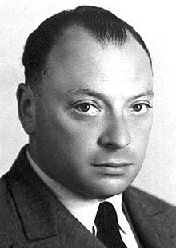
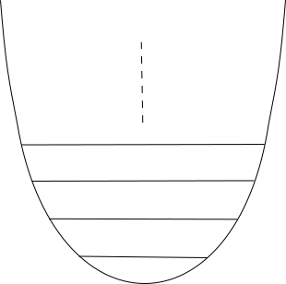





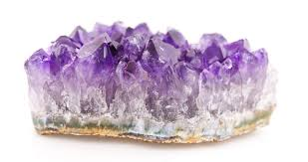
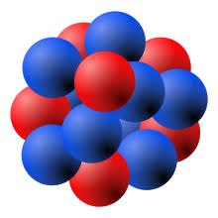
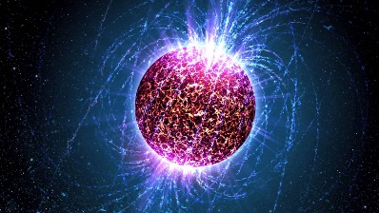


Slide 4




Slide 5
Outline
Introduction of generalized Pauli constraints
study of concrete systems
GPCs relevant: (approx.) saturated/(quasi)pinning
implications/
applications
RDMFT
exclusion principle
for hard-core bosons
``exchange force‘‘
A
B
C

Slide 6











1
0
1

Slide 7





[R.E.Borland, K.Dennis, J. Phys. B, 5, 1972],
[M.B.Ruskai, Phys. Rev. A, 40, 2007]

Slide 8


[A.Klyachko, J. Phys. Conf. Ser. 36, 72, 2006]
[M.Altunbulak, A.Klyachko, CMP 282, 287, 2008]

Slide 9



What is the physical relevance of the GPCs?
1
0
1

Slide 10
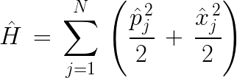

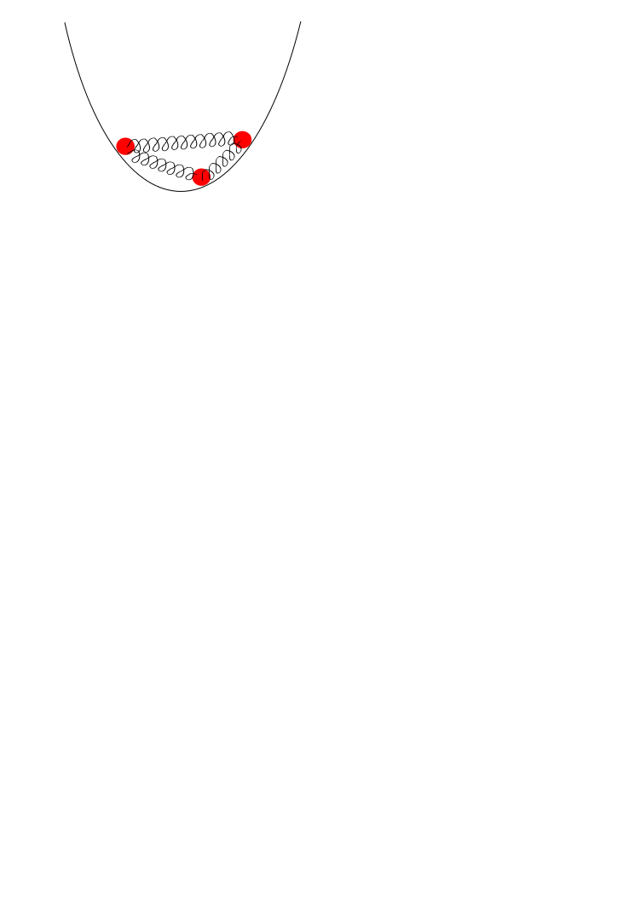



Analytically solvable model: Harmonium

Slide 11

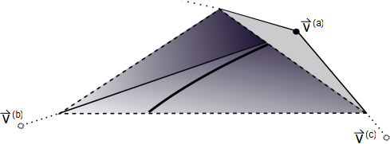



[CS, PhD thesis, ETH Zurich (2014)]
[ CS, D.Gross, M.Christandl, Phys. Rev. Lett. 110, 040404 (2013)]

Slide 12




1
0
1

Slide 13




[F.Tennie, D.Ebler, V.Vedral, CS, Phys. Rev. A 93, 042126 (2016)]
[F.Tennie, V.Vedral, CS, Phys. Rev. A 94, 012120 (2016)]
[F.Tennie, V.Vedral, CS, Phys. Rev. A 95, 022336 (2017)]
[O.Legeza, CS, Phys. Rev. A 97, 052105 (2018)]
+ many more papers in quantum chemistry

Slide 14

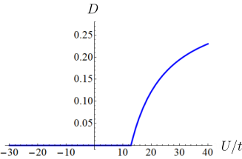
Hubbard model
[CS, Phys. Rev. B 92, 155149 (2015)]

Slide 15








Slide 16
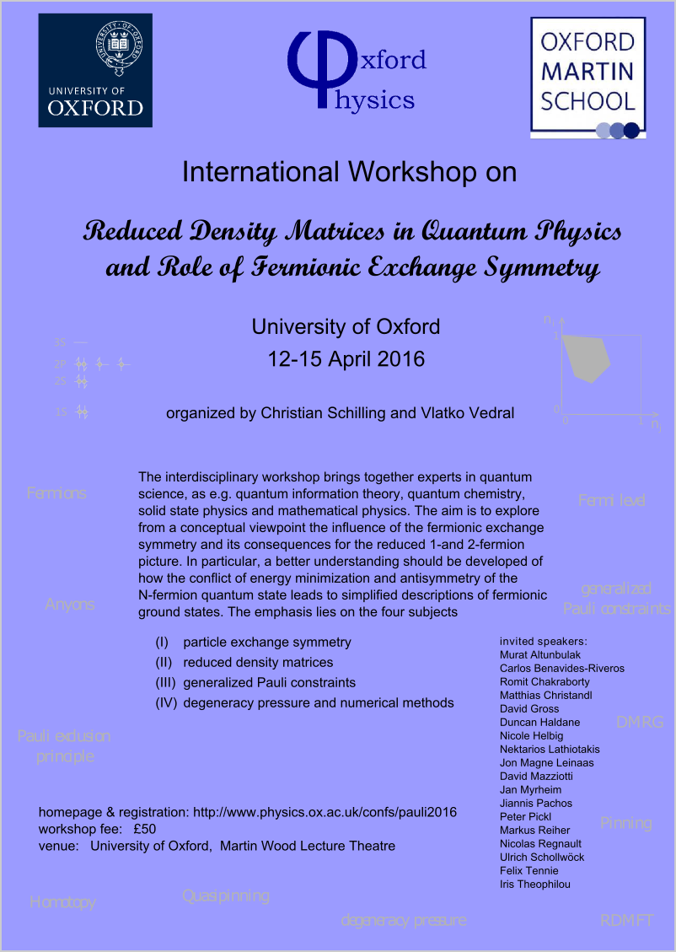
International workshop on those new research concepts
See website
www.physics.ox.ac.uk/confs/pauli2016
for recorded talks, slides, posters,...

Slide 17




A
B
C

Slide 18






A) Implications/applications
0
1

Slide 19


detector
physical
system
1
[CS, Phys. Rev. B 92, 155149 (2015)]
0
1

Slide 20







Slide 21


Slide 22

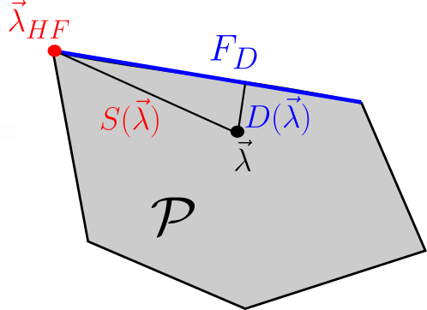
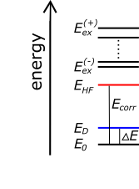
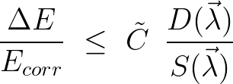

Slide 23




Hierarchy of generalized Hartree-Fock ansatzes

Slide 24





B) Reduced Density Matrix Functional Theory

Slide 25

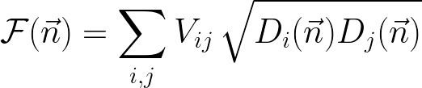

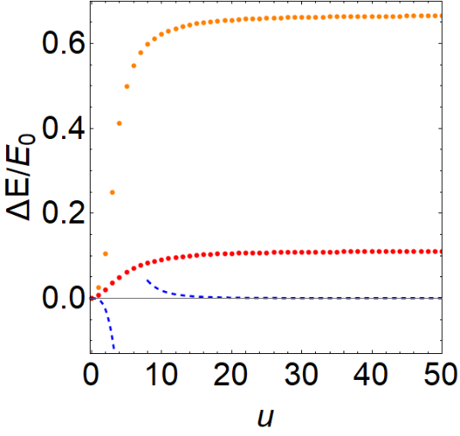
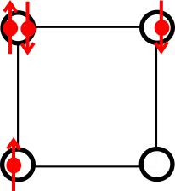

Slide 26
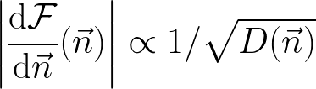

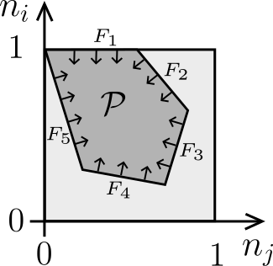


Slide 27








C) Exclusion principle for hard-core bosons

Slide 28
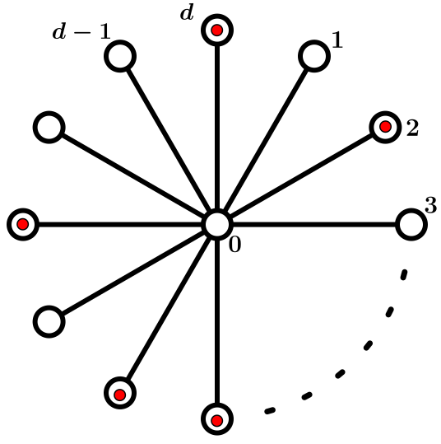

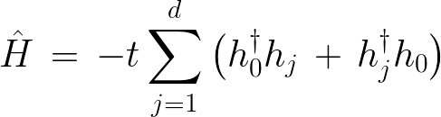

Slide 29


Conclusion

Slide 30



Thank you!

Slide 31
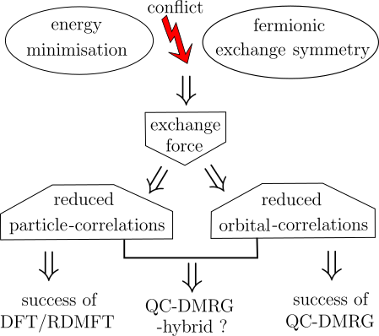
D) Future research programme
(II)
(I)
(III)

Slide 32






(I) Foundation for fermionic correlation

Slide 33


(II) RDMFT and exchange force

Slide 34


(III) Improvements of QC-DMRG

Slide 35
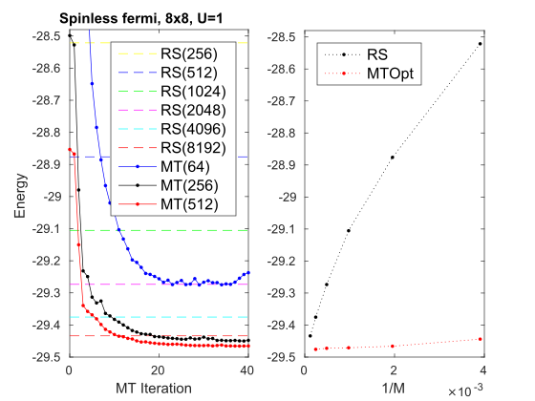

Slide 36



Slide 37







tremendous effort
N = 3

Slide 38







pinning analysis
too difficult/
not known yet
instead: check w.r.t
`concept of truncation’ [CS, PhD thesis, ETH Zurich, 2014]

Slide 39





relevant as long
as
lower bound on
pinning order

Slide 40







relevant as long
as
quasipinning
Phys. Rev. Lett. 110, 040404 (2013)

Slide 41


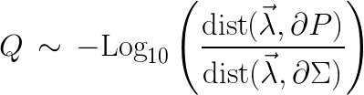

How about
intermediate couplings?
more particles?
higher spatial dimensions?
After all, how nontrivial are these findings?:
???
1
[F.Tennie, V.Vedral, CS, arXiv:1509.00358]
0
1

Slide 42
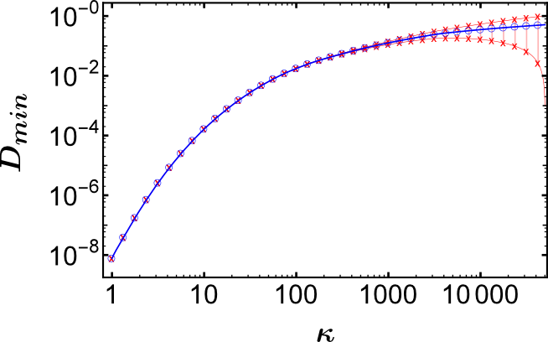

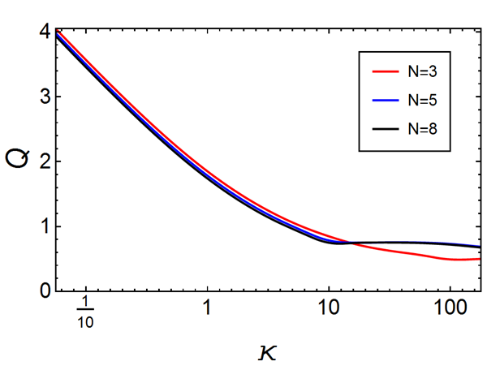

intermediate
couplings:
more particles:
nontriviality:
[F.Tennie, D.Ebler, V.Vedral, CS, Phys. Rev. A 93, 042126 (2016)]

Slide 43
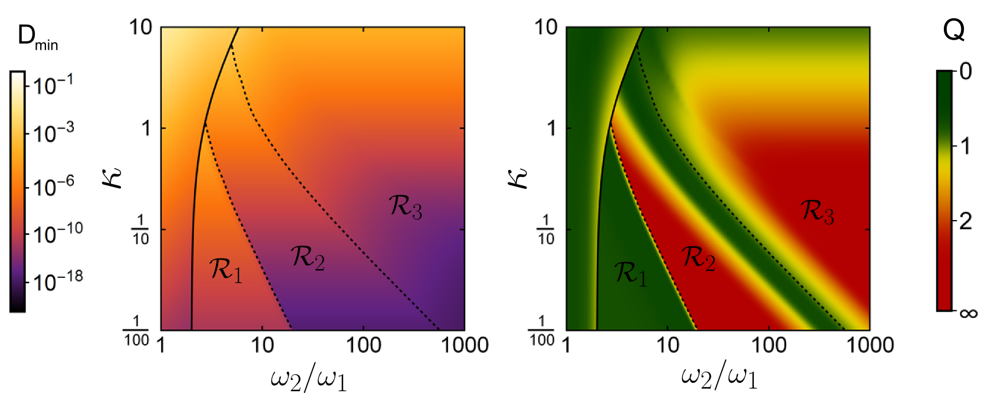
higher spatial dimensions & crossovers:
… many further plots …
[F.Tennie, V.Vedral, CS, Phys. Rev. A 94, 012120 (2016)]

Slide 44
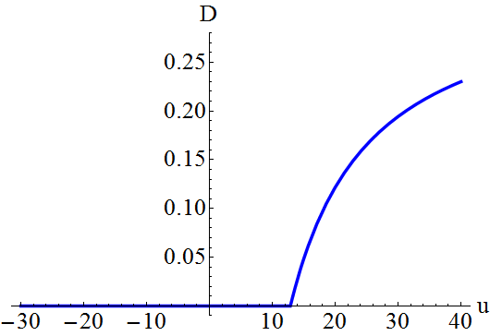
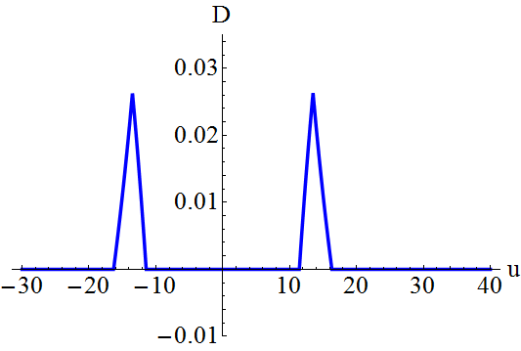
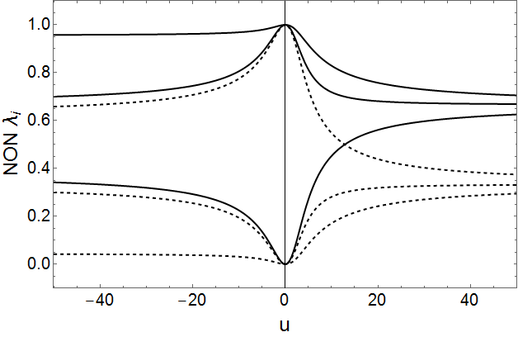
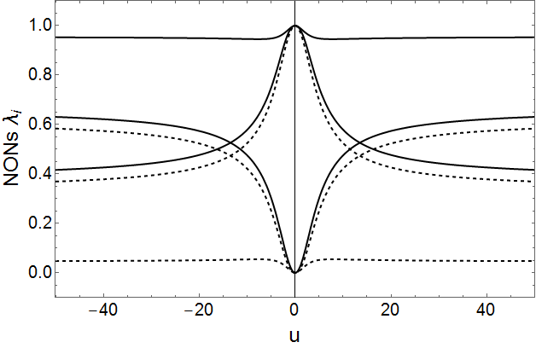
Hubbard model
e.g. 3 electrons on 3 sites:
ground state
excited state

Slide 45
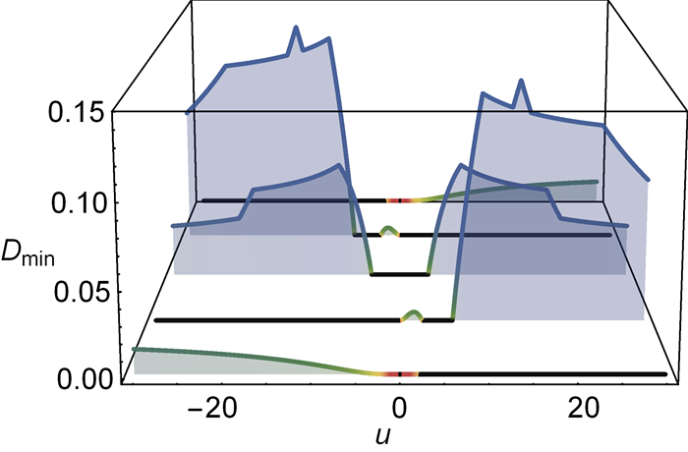
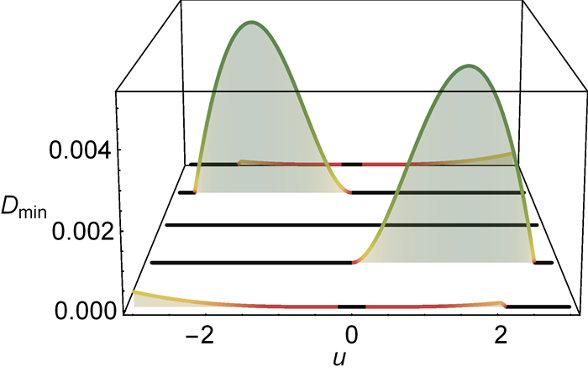

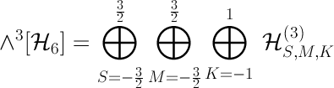
3 electrons on 4 sites:
pinning requires symmetries:
[CS, Phys. Rev. B 92, 155149 (2015)]

Slide 46


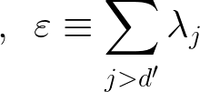
1
0
1
???

Slide 47
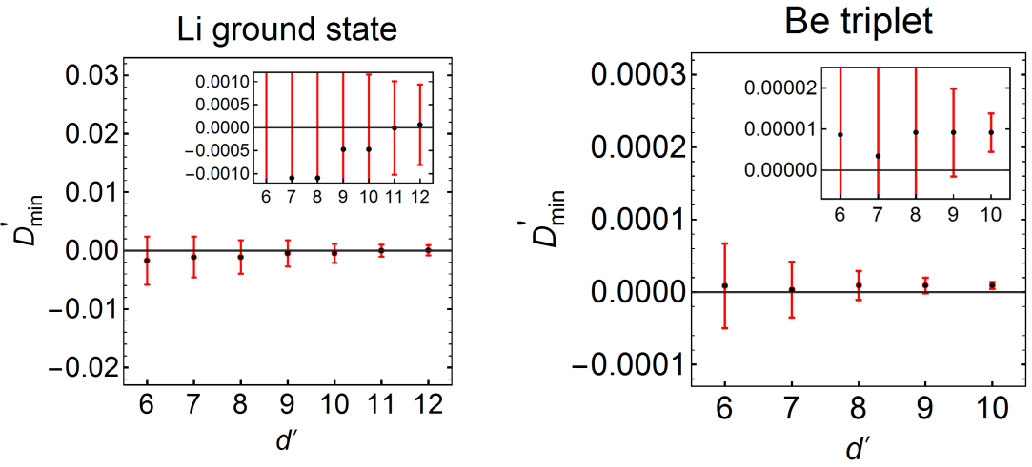
[CS, M.Altunbulak, S.Knecht, A.A.Lopes, J.D.Whitfield, M.Christandl, D.Gross, M.Reiher: Phys. Rev. A 97, 052503 (2018)]

Slide 48
Quantum Chemistry:
(quasi)pinning
[C.L.Benavides-Riveros, J.M.Gracia-Bondia, M.Springborg:
Phys. Rev. A 88, 022508 (2014); arXiv:1409.6435; Phys. Rev. A 92, 012512 (2015);
Chem. Mod. 14, 71 (2018)]
[R.Chakraborty, D.A.Mazziotti:
Phys. Rev. A 89, 042505 (2014); Phys. Rev. A 91, 010101 (2015);
Int. J. Quant. Chem. 115, 1305 (2015); Int. J. Quant. Chem. 116, 784 (2016);
J. Chem. Phys. 148, 054106 (2018)]
[I.Theophilou, N.N.Lathiotakis, M.A.L.Marques, N.Helbig:
J. Chem. Phys. 142, 154108 (2015); J. Chem. Theory Comput. 12, 2668 (2016);
J. Chem. Phys. 148, 114108 (2018)]
[CS, M.Altunbulak, S.Knecht, A.A.Lopes, J.D.Whitfield, M.Christandl,
D.Gross, M.Reiher:
Phys. Rev. A 97, 052503 (2018)]

Slide 49


structual simplifications for N-fermion state
1
0
1
stable:

Slide 50





