Slide 1
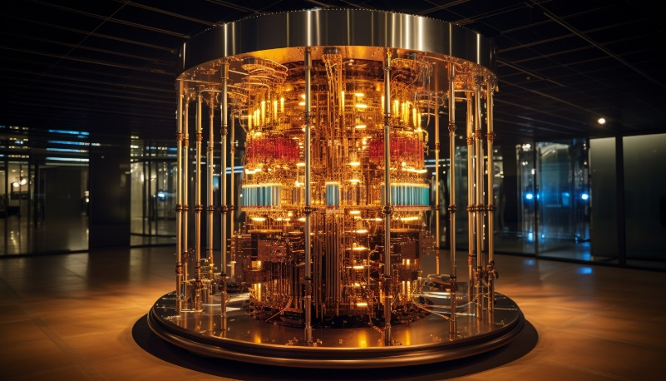
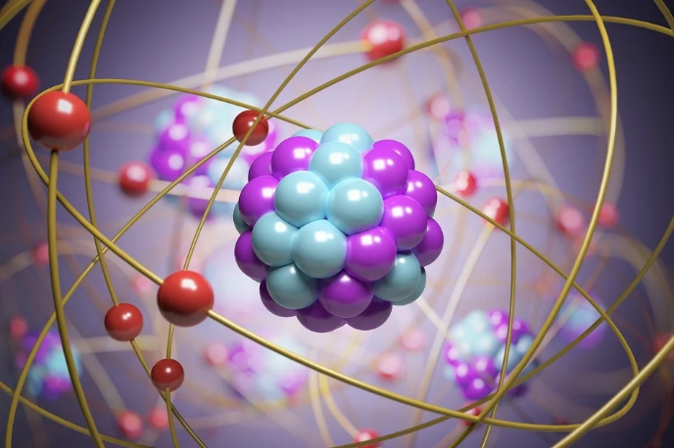
Quantum computing for quantum chemistry
Christian Schilling
6th October 2025
partly based on lectures/tutorials/articles by
Artur Izmaylov (Youtube)
Stefan Knecht (ESQC)
Cheng-Lin Hong (MQV)
Garnet Chan (Faraday discuss. 24)
Notes:
1

Slide 2





Slide 3
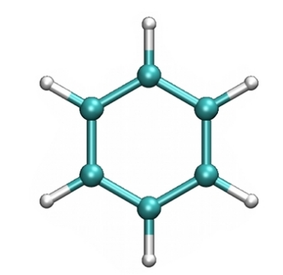







exponential wall/scaling
[L.Veiss, Juelich Correl21]

Slide 4
Significance of interacting particle systems?
Which systems?
Why to simulate them
on a computer?

Slide 5
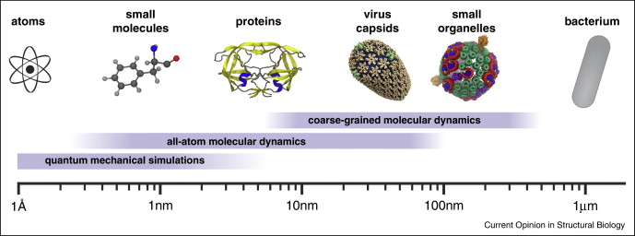
Systems

Slide 6

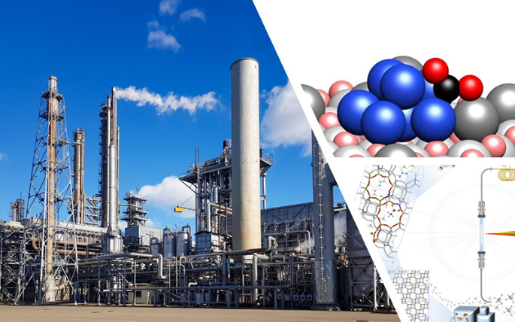
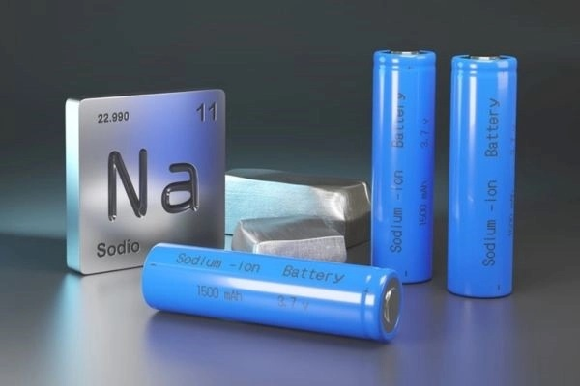

Significance
pharmaceuticals
industrial catalysis
battery materials
screens & processors

Slide 7
Simulation (on a computer)?
accelerating drug discovery by modelling reaction mechanisms
reducing cost and waste of expensive materials (Pt, Ir, Li, Co)
avoiding toxic, radioactive, or explosive substances
(uranium oxides and plutonium compounds, nerve agents)
exploring systems that cannot be manipulated in the lab
(Astrochemistry, ultrafast reactions)

Slide 8
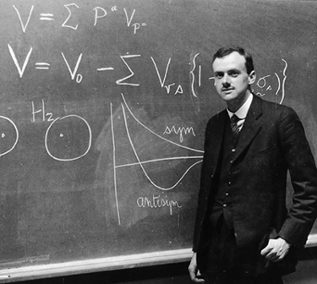
“The underlying physical laws necessary for the
mathematical theory of a large part of physics and the
whole of chemistry are thus completely known, and the
difficulty is only that the exact application of these laws
leads to equations much too complicated to be soluble.
It therefore becomes desirable that approximate practical methods of applying quantum mechanics should be developed, which can lead to an explanation of the main features of complex atomic systems without too much computation.” (Paul A. M. Dirac,1929)

Slide 9




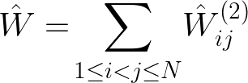




Slide 10
classical computer
or
quantum computer?

Slide 11
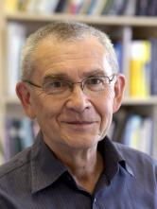
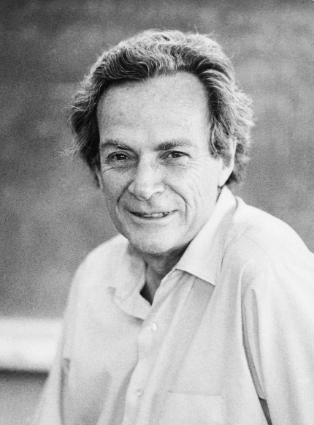
[...] nature isn’t classical,
dammit, and if you want to make a simulation of nature, you’d better make it quantum mechanical, and by golly it’s a wonderful problem, because
it doesn’t look so easy.
Yurin Manin
“Computable and uncomputable” (1980)
Richard Feynman
“Simulating Physics with computers” (1982)

Slide 12
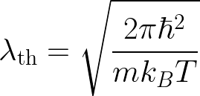
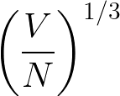



Quantum versus classical: An estimation
Ideal gas:
electrons
& nuclei:
(T=298K)
atomic scale
electrons: quantum
nuclei: classical

Slide 13
Outline
Notation & concepts
Variational principles
Classical methods in Quantum Chemistry
Fermion-to-qubit mapping
Estimating energy expectation values
Variational quantum eigensolver

Slide 14
1) Notation & concepts

Slide 15

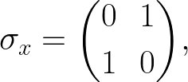
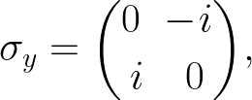
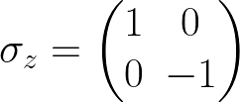

Conventions
use of Hartree atomic units:
length in units of Bohr radius, energies in Hartrees
energy (gaps) with chemical accuracy:
leading order of reaction rates correct (Eyring)
Pauli matrices/operators:
or
or

Slide 16
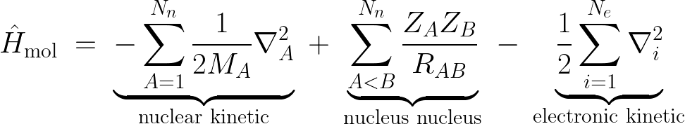
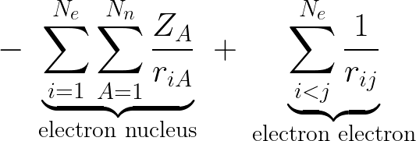
molecular Hamiltonian

Slide 17

Born-Oppenheimer approximation
“nuclei move slower than electrons”
separation of nuclear and electronic degrees:

Slide 18





Hilbert spaces & truncations
1-particle Hilbert space:
by choosing finite basis
set of atomic orbitals
truncation
with dimension

Slide 19



N-fermion Hilbert space
with dimension
Fock space
with dimension

Slide 20


2nd quantization (w.r.t. orthonormal basis for ):

Slide 21
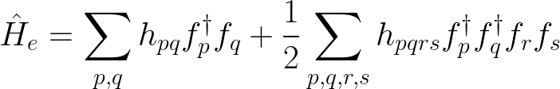
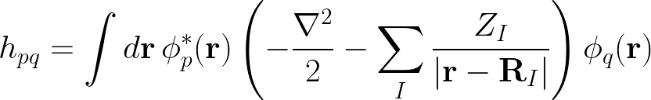

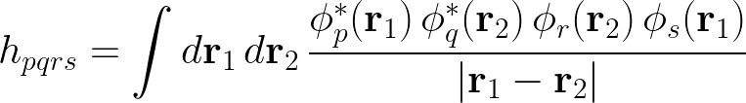
Hamiltonian in 2nd quantization
where (according to Slater-Condon rules):
time:

Slide 22
2) Variational principles

Slide 23


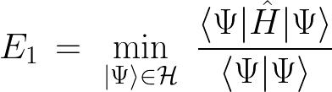




Rayleigh-Ritz
given Hamiltonian with
ground state
1st excited state

Slide 24



ensemble variational principle
[Gross, Oliveira, Kohn, Phys. Rev. A, 37, 2805 (1988)]
[Ding, Hong, Schilling, Quantum 8, 1525 (2024)]

Slide 25
3) Classical methods in Quantum Chemistry

Slide 26


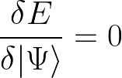




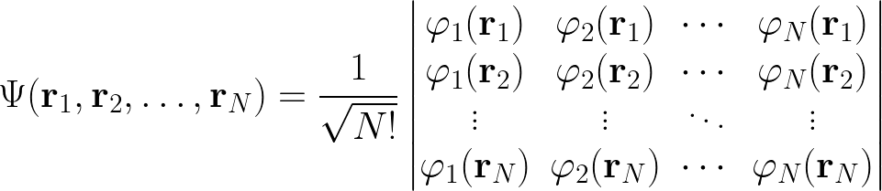
Hartree-Fock ansatz
Hartree-Fock energies & orbitals

Slide 27
beyond Hartree-Fock: electron correlation
correlation energy (Löwdin):
dynamic correlation:
instantaneous interactions with other electrons
perturbative
weakly correlated, but affects quantitative accuracy
static correlation:
near-degenerate configurations
non-perturbative
strongly correlated, qualitatively important

Slide 28






Configuration Interaction (CI)
single (S) double (D) triple (T) …
hierarchy of ansatzes:
CISD, CISDT, etc.
…

Slide 29
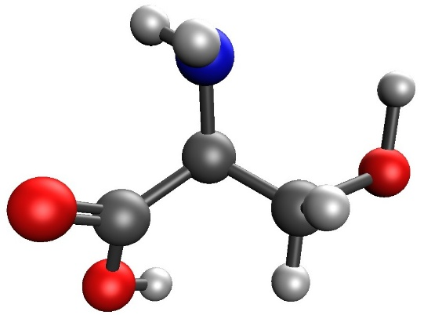
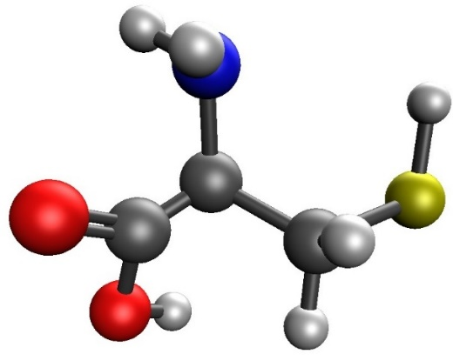
Size conistency
Configuration Interaction is not size-consistent as
very bad

Slide 30



Coupled Cluster (CC)
hierarchy of size-extensive ansatzes:
CCSD, CCSDT, etc.
as

Slide 31
Summary (classical methods)
mean-field theory provide foundation for most chemical intuition
the ‘right’ methods work remarkably well, yet we
have no formal theory of errors
challenge for computational chemistry:
How to treat strong correlation?

Slide 32
[...] nature isn’t classical,
dammit, and if you want to make a simulation
of nature, you’d better make it quantum mechanical […]
Yurin Manin
“Computable and uncomputable” (1980)
Richard Feynman
“Simulating Physics with computers” (1982)

Slide 33

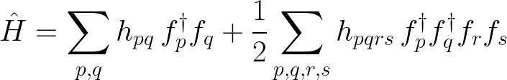
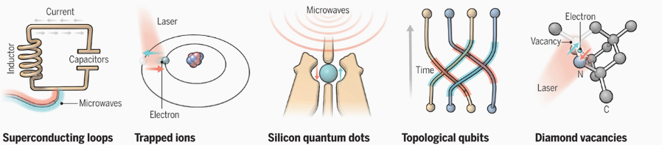
Quantum computing workflow
ab initio Hamiltonian
system & geometry
output
qubit
platform
quantum
algorithm

Slide 34
Quantum algorithms
Variational (NISQ-era) algorithms
• Variational Quantum Eigensolver (VQE)
• Quantum Imaginary Time Evolution (QITE)
State preparation + phase estimation (fault-tolerant era)
• Quantum Phase Estimation (QPE) and related techniques

Slide 35
4) Fermion-to-qubit mapping

Slide 36





general setting/goal
fermions
qubits
isomorphism

Slide 37







Jordan-Wigner (1928)
fermions
qubits
CAR fufilled
overhead

Slide 38





effect on wavefunctions
fermions
qubits

Slide 39

alternative mappings
parity mapping
overhead
Bravyi-Kitaev mapping
overhead
references:
[P. Jordan and E. Wigner, Z. Phys. 47, 631 (1928)]
[S. Bravyi and A. Kitaev, Ann. Phys. 298, 210 (2002)]
[F. Verstraete and J. I. Cirac, J. Stat. Mech.: Theory Exp., P09012 (2005)]
[J. T. Seeley, M. J. Richard, and P. J. Love, J. Chem. Phys. 137, 224109 (2012)]

Slide 40
5) Estimating energy expectation values

Slide 41
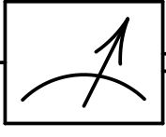




measurement of single qubits
given device :
measurement of
measurement of

Slide 42

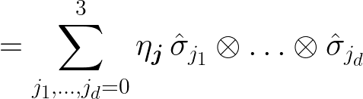



measurement of Hamiltonian
system of d qubits: cannot directly measure
estimation of by measuring fragments:
e.g.
however, Pauli strings to measure
quantum chemistry
`only’ Pauli strings to measure

Slide 43





reduction of measurements
idea: identify commuting Pauli strings
e.g.
or
in general: two Pauli strings either commute or anticommute

Slide 44






measurement process
estimating
corresponds to sampling random variable
uncertainty:

Slide 45




Shot noise
K times sampling sampling once
uncertainty:
estimating
different sampling strategies:
[Arrasmith, Cincio, Somma, Coles, arXiv:2004.06252]

Slide 46
6) Variational quantum eigensolver

Slide 47
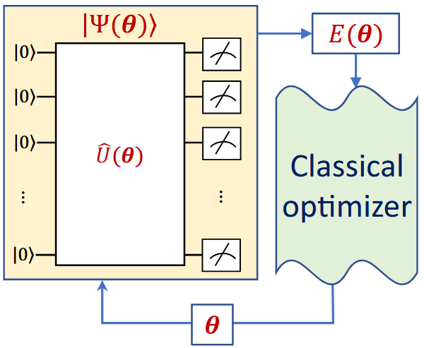
hybrid scheme
some
suitable
ansatz
[graphics from Commun. Physics 6, 4 (2023)]

Slide 48


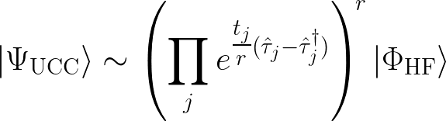

Unitary Coupled Cluster
Trotter decomposition
typically first order:
Fermion-qubit mapping
[Babbush, McClean, Wecker, Aspuru-Guzik, Wiebe, Phys. Rev. A 91, 022311 (2015)]

Slide 49
2-qubit building blocks
quantum circuit representation of exponentiated Paulis:
(Pauli gadget)

Slide 50
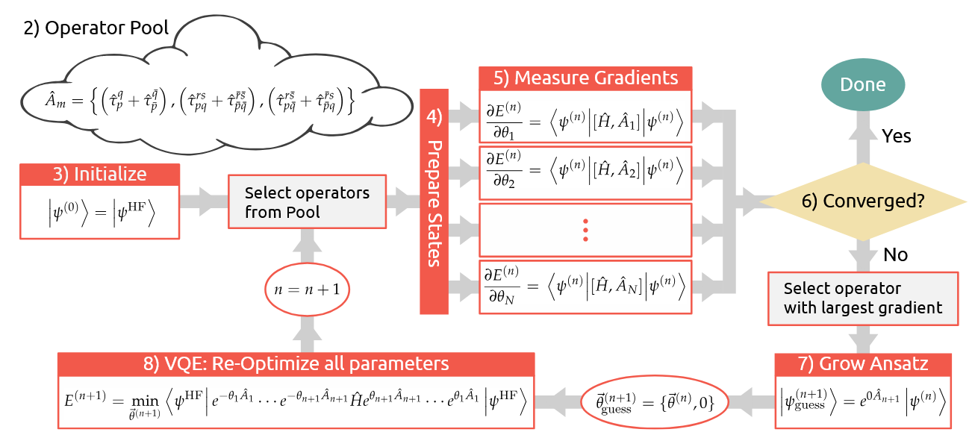
ADAPT VQE
ansatz of UCC too rigid + Trotter error alternative approach
[Grimsley, Economou, Barnes, Mayhall, Nature Commun.10, 3007 (2019)]

Slide 51
Outlook

Slide 52
Quantum advantage in Quantum Chemistry (?)
classical
hard
quantum
easy
high utility

Slide 53
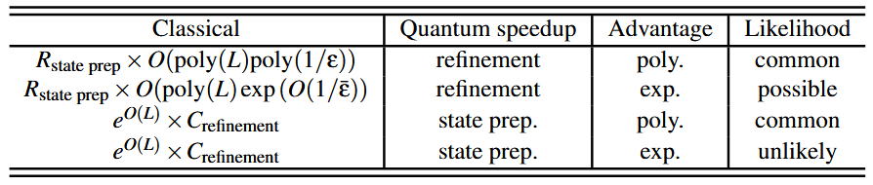


expectation
total cost/time:
quantum advantage refers to
[Chan, Faraday Discuss., 254, 11 (2024)]

Slide 54
Thank you!
Any questions?

